Slide 1
Part3 要点
答题思路：引导句+观点1+解释+举例/结果
一个最好讲的要点，清楚详细地阐述
当季part3新题:What changes has the development of technology brought about in our lives? 答- •(引导句）I believe that there are several changes. •(改变1）I guess the most important change is that technology has provided entertainment to our lives. •(解释)With modern technology such as TVs and tablets, we can relax and unwind after a long day at work. •(例子)For example, a lot of people have Netflix or Amazon Prime subscriptions nowadays, therefore, they can slump down in front of the TV, put their feet up and binge-watch movies at home anytime.
Is public transport popular in your country?
1. (直接回答) Yes, definitely! The majority of people in China use public transport for their daily commute. 2. (原因) This is because public transport is convenient and time-saving. 3. (解释) Most cities in China are densely populated, which often causes traffic issues such as congestion. 4. (结果) By using subways and express buses, people can avoid being stuck in traffic jams during peak hours, that’s why public transport is people’s go-to option for daily travel.

Slide 2
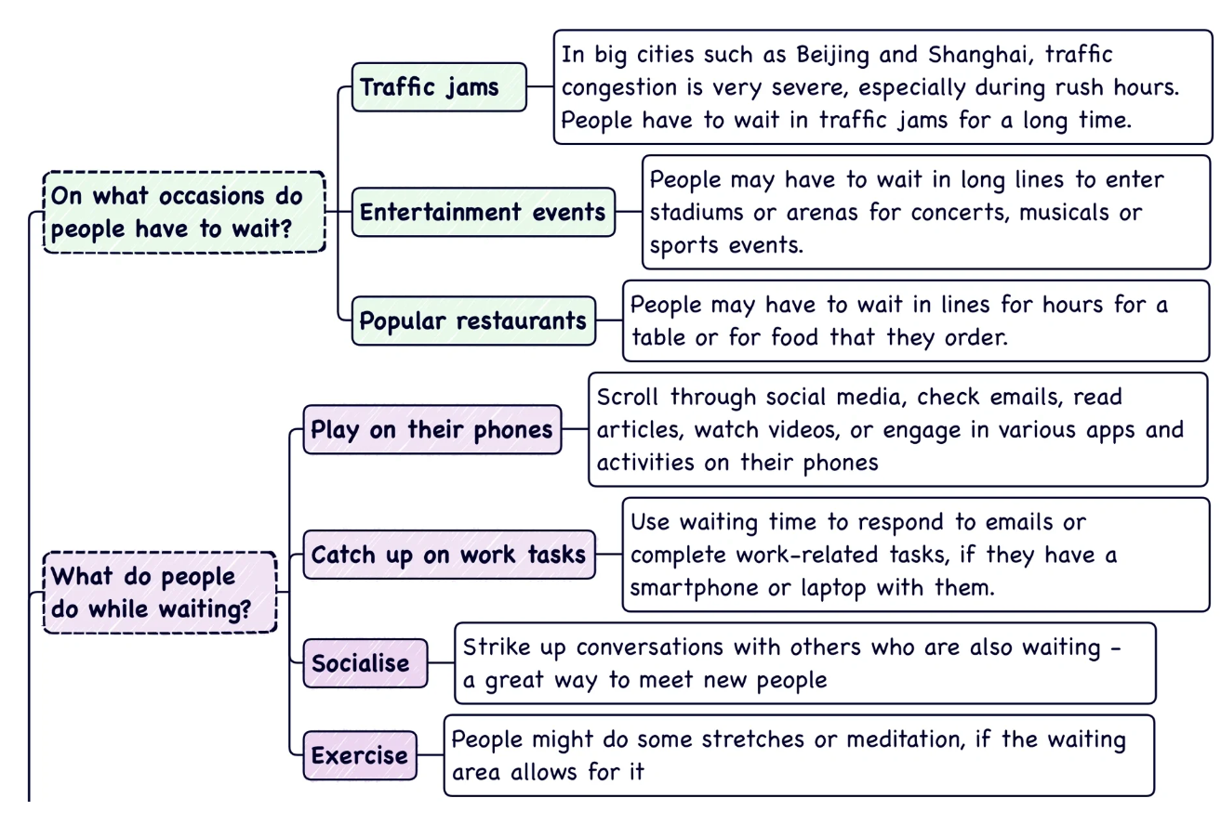
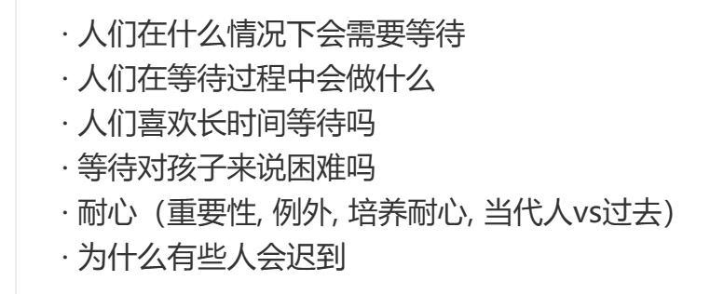
Waiting

Slide 3
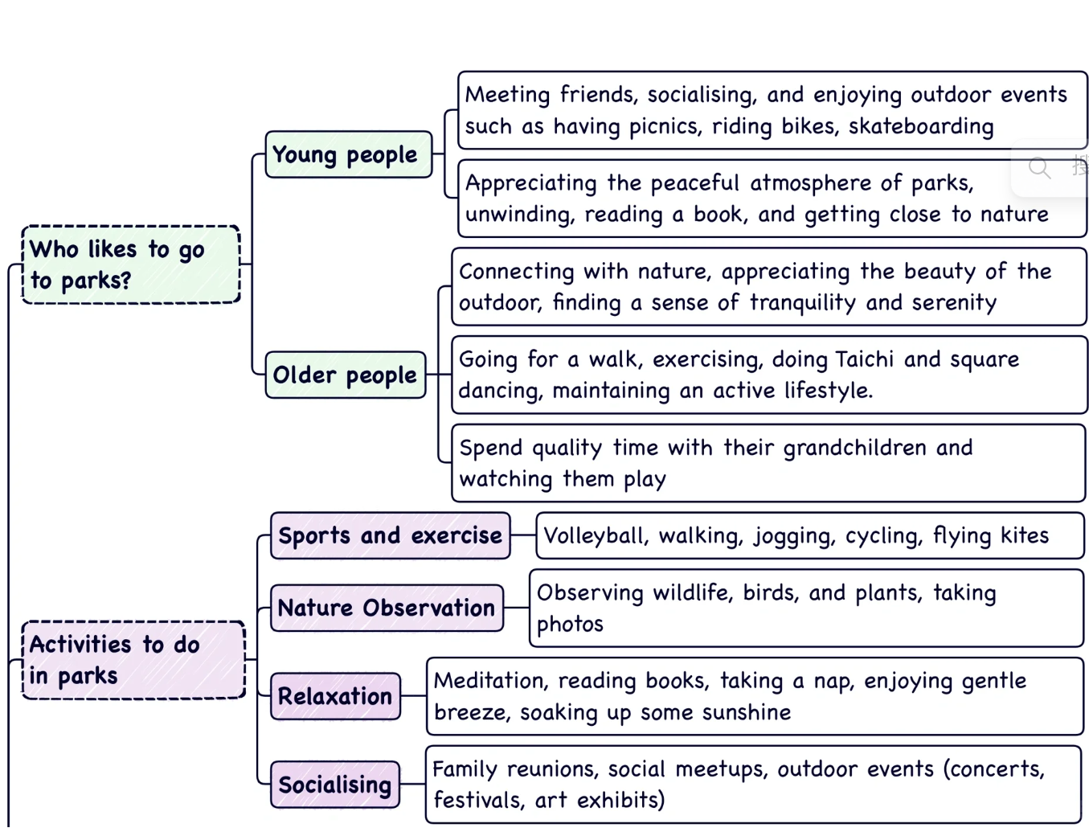
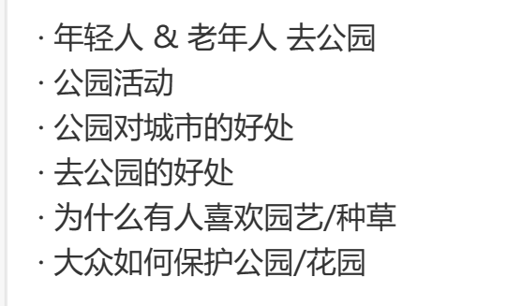
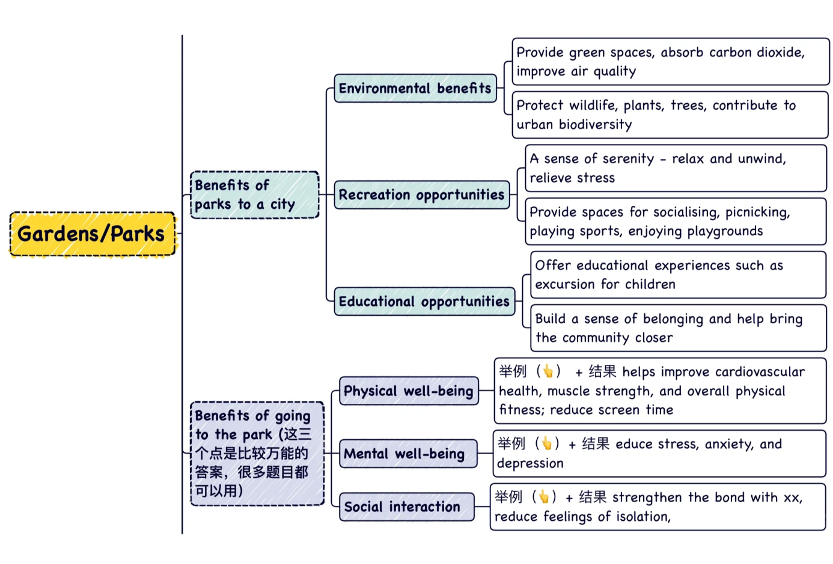
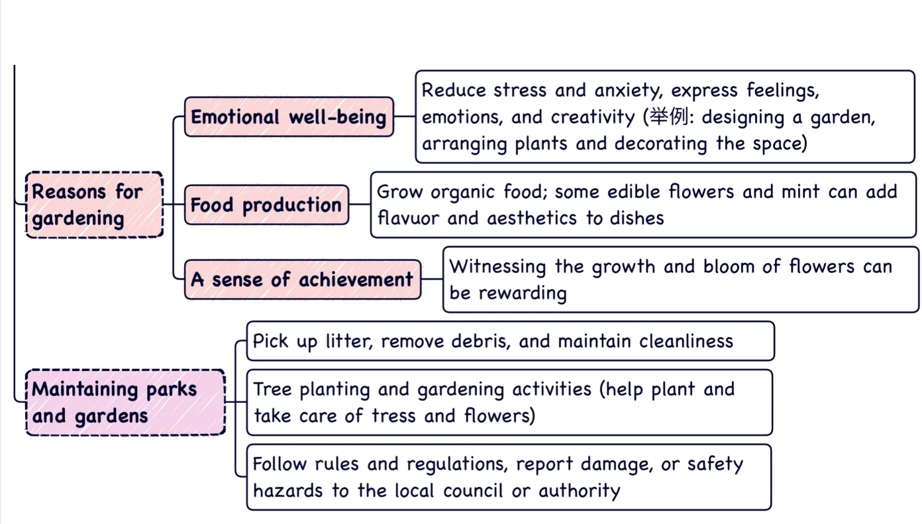
Park

Slide 4
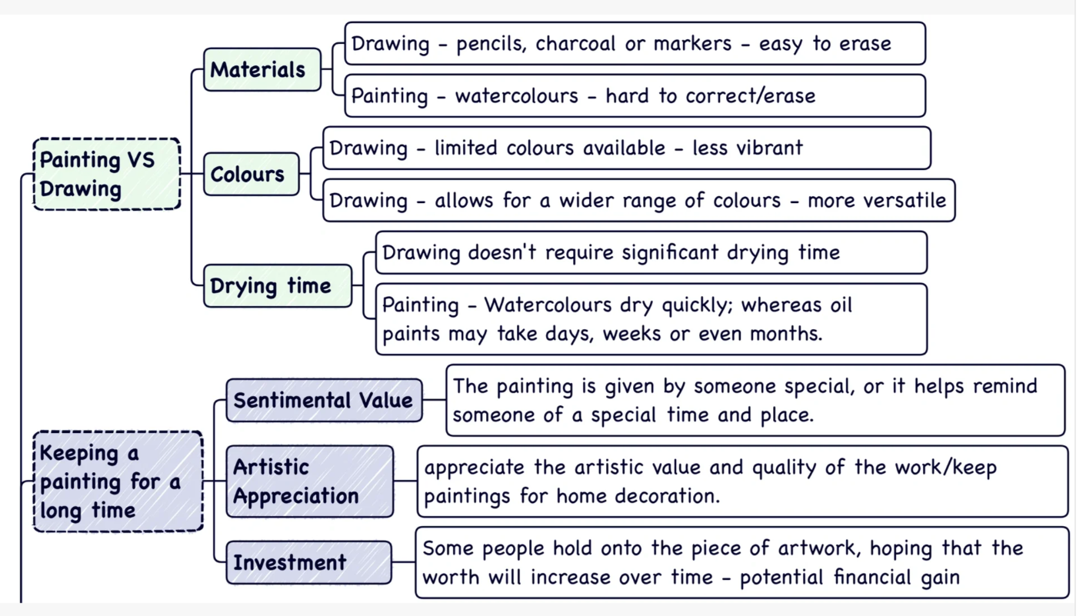
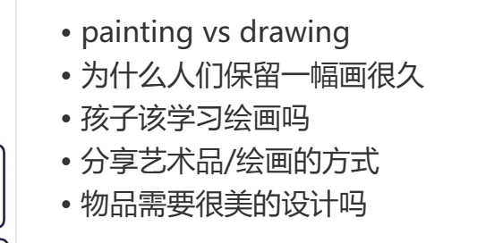
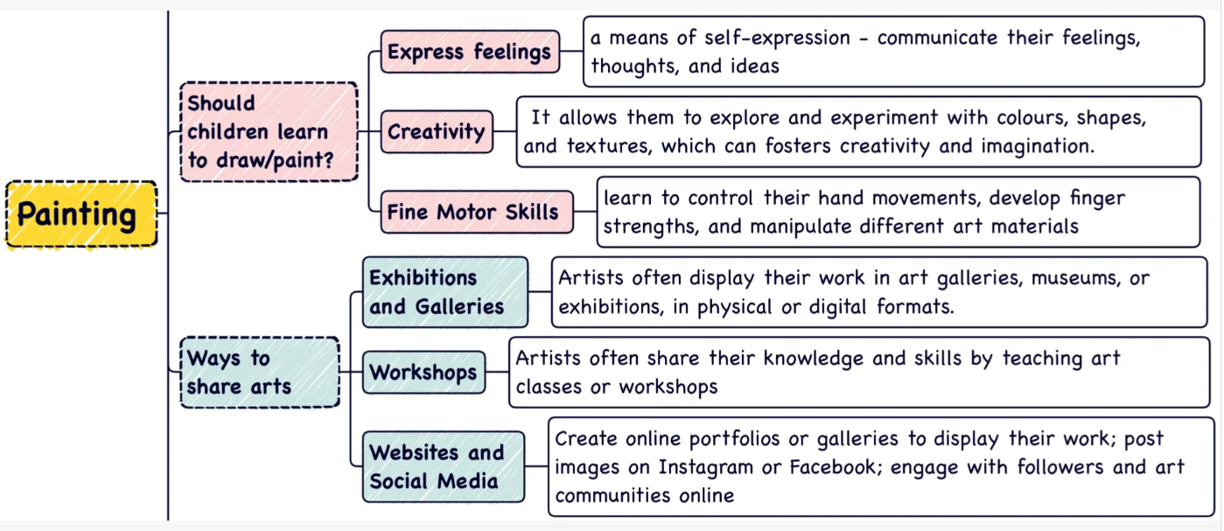
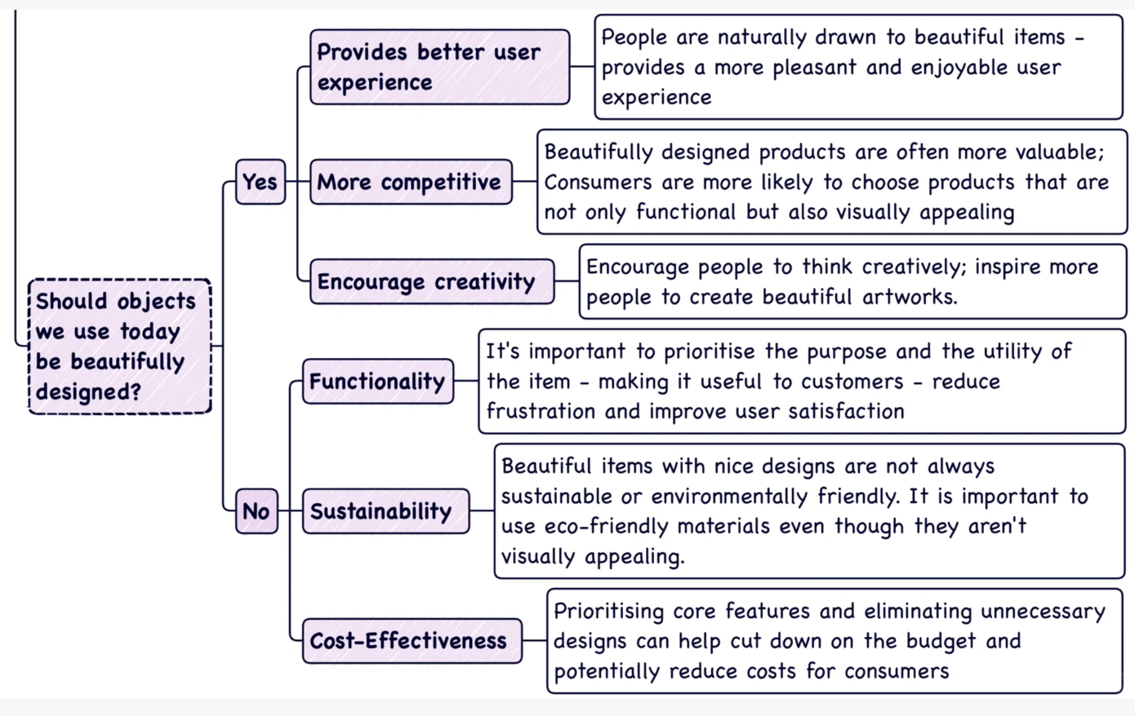
Paint

Slide 5
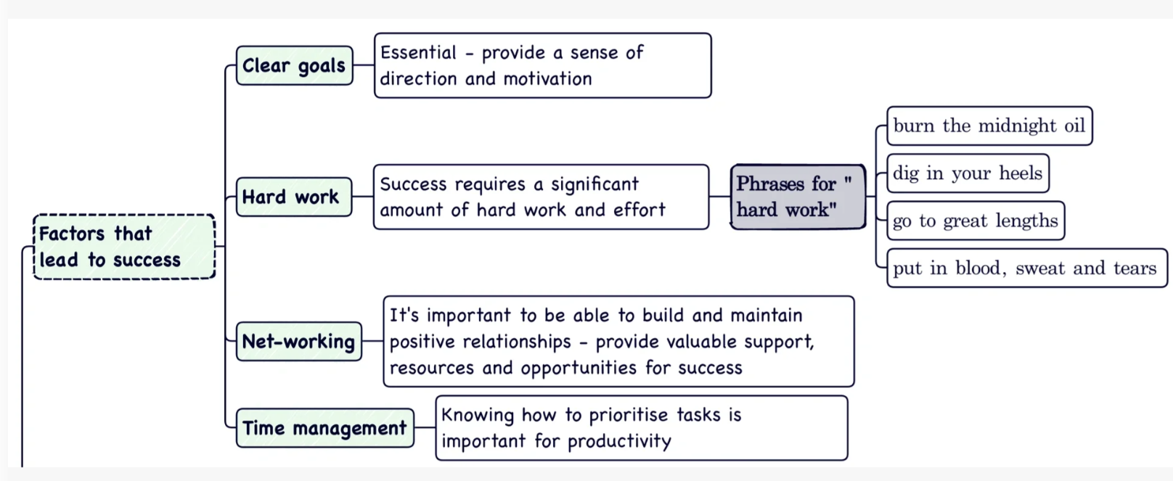
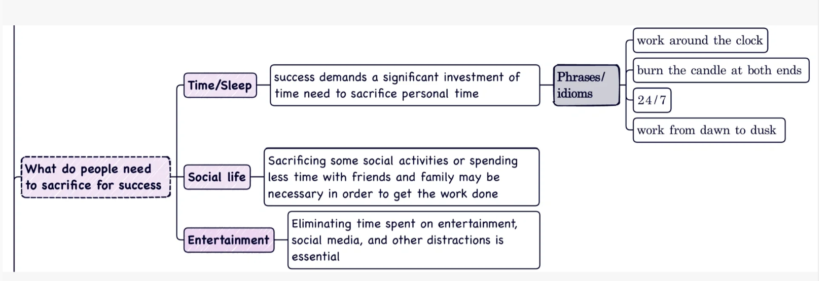
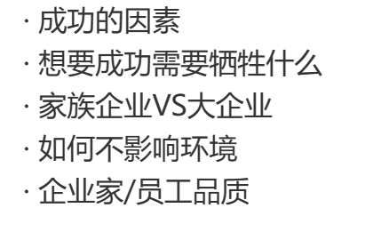
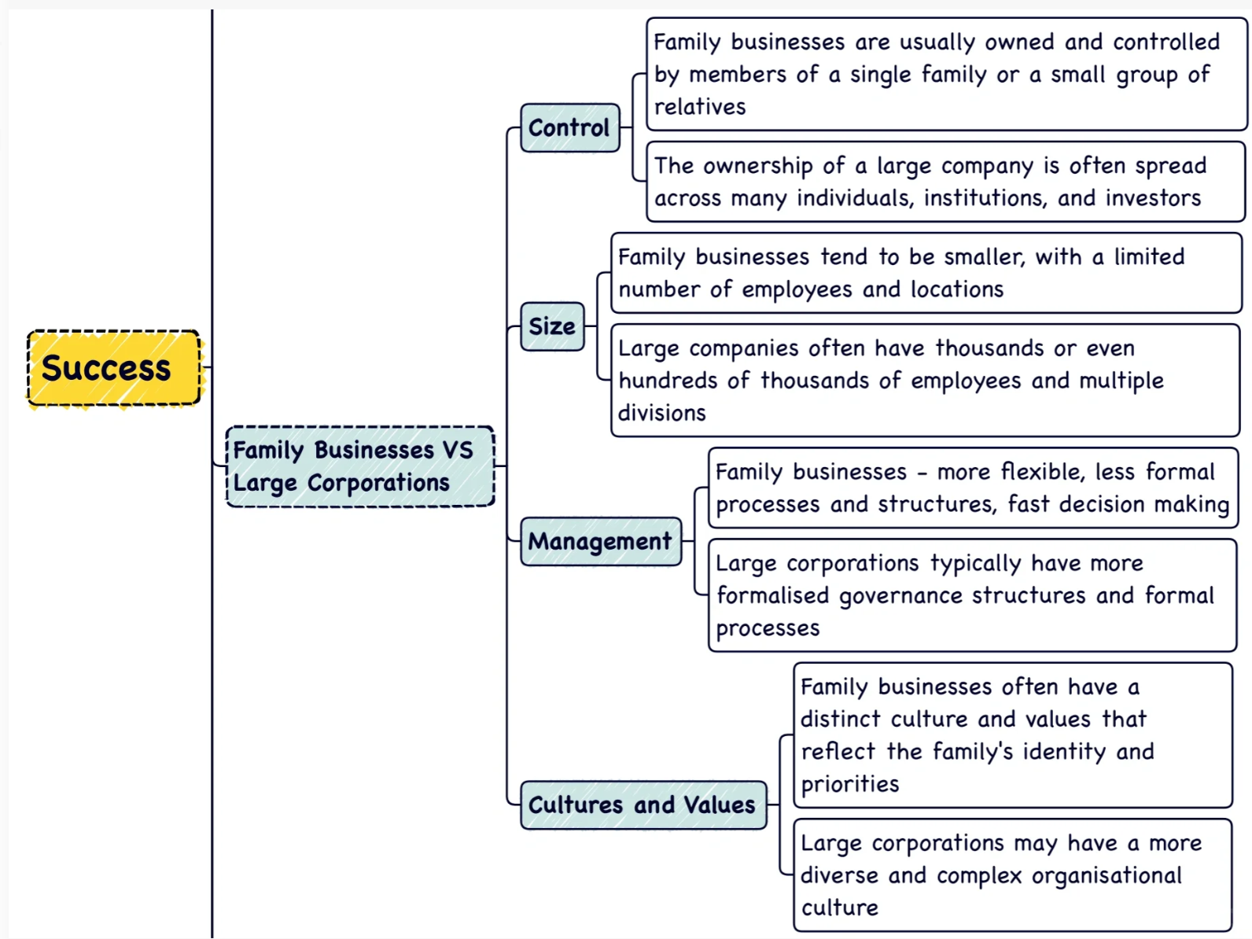
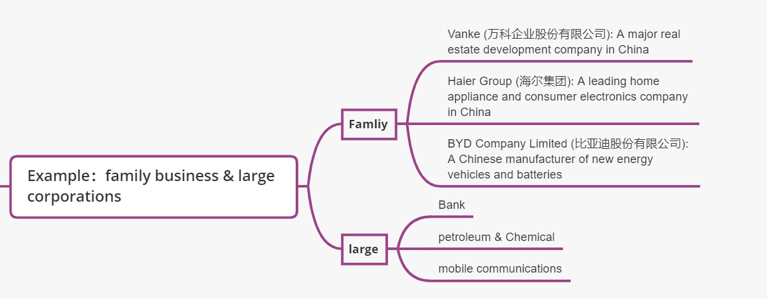
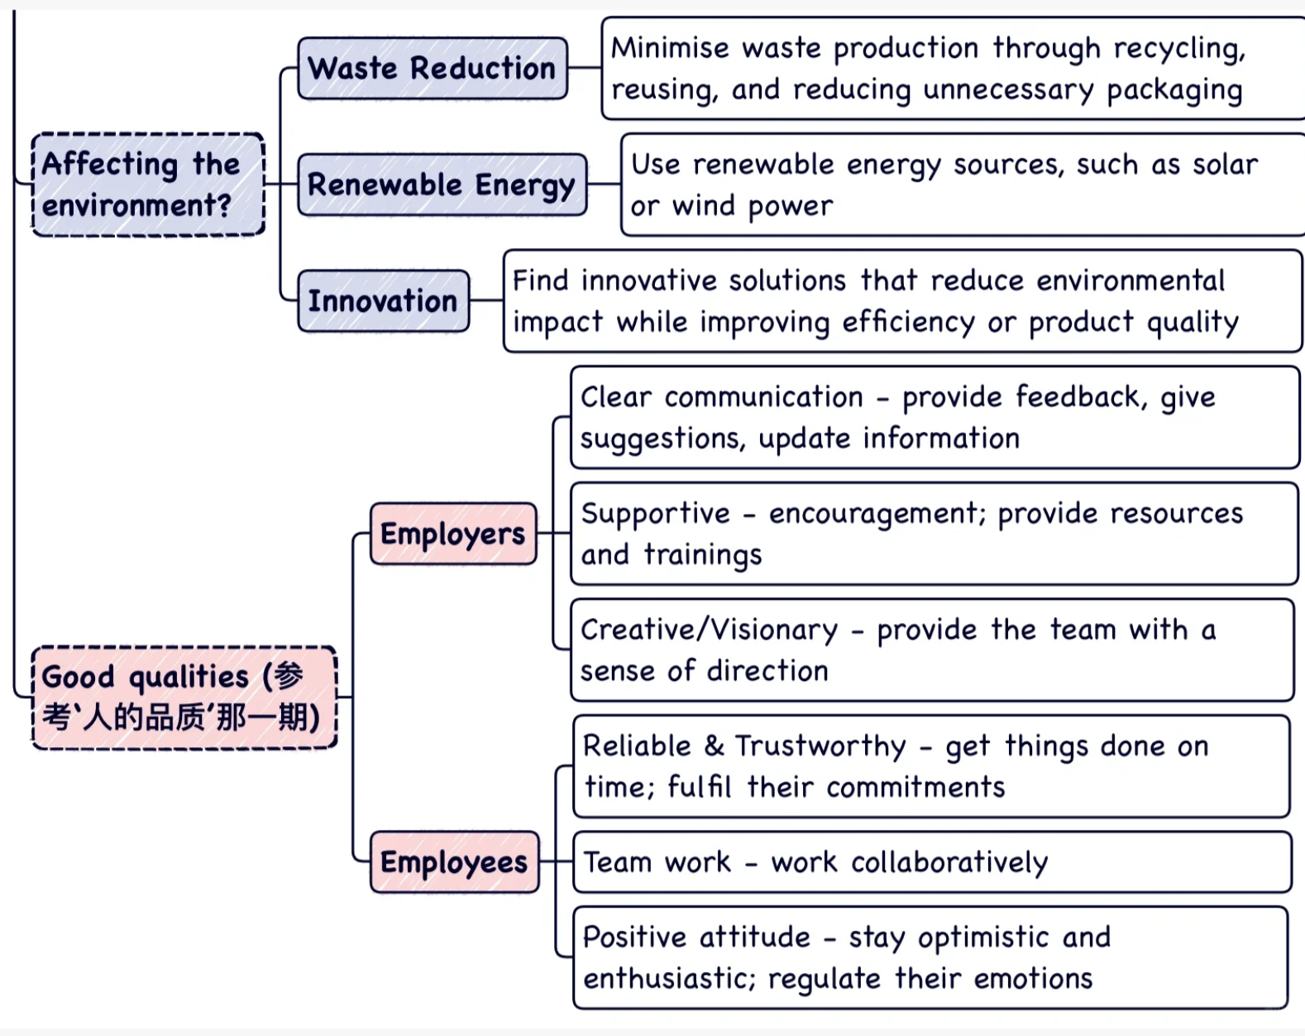
Success
State-owned

Slide 6
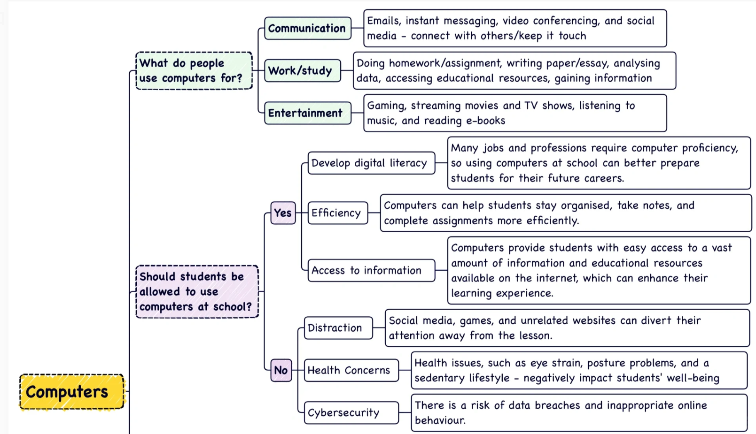
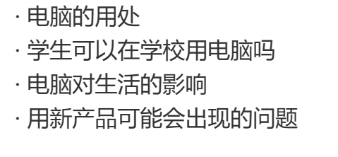
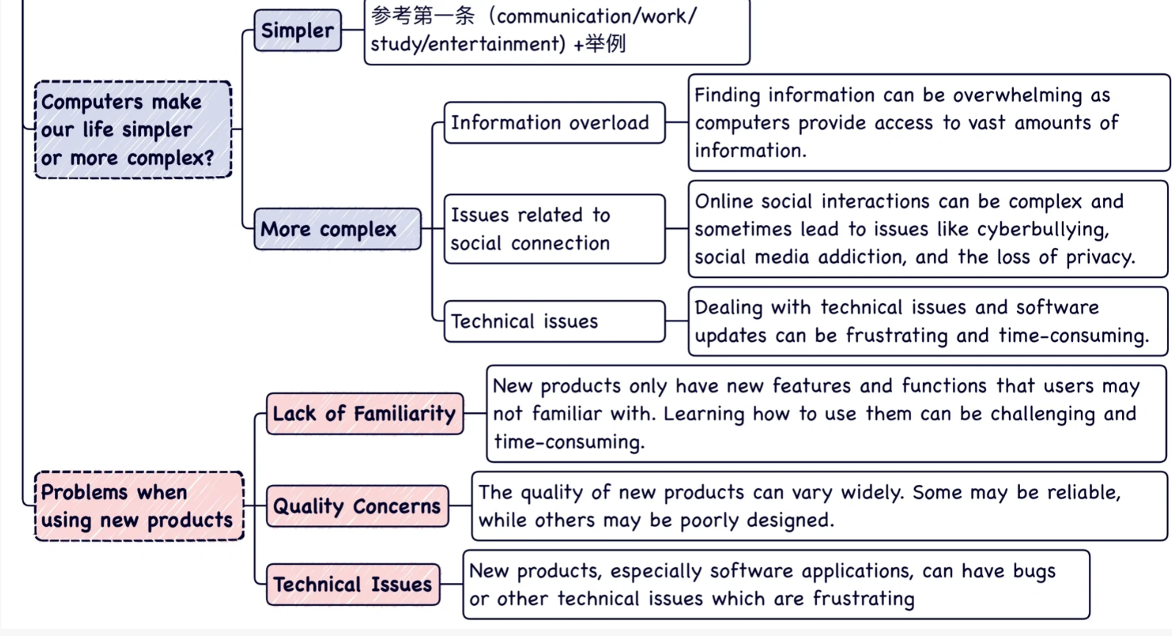
Computer

Slide 7
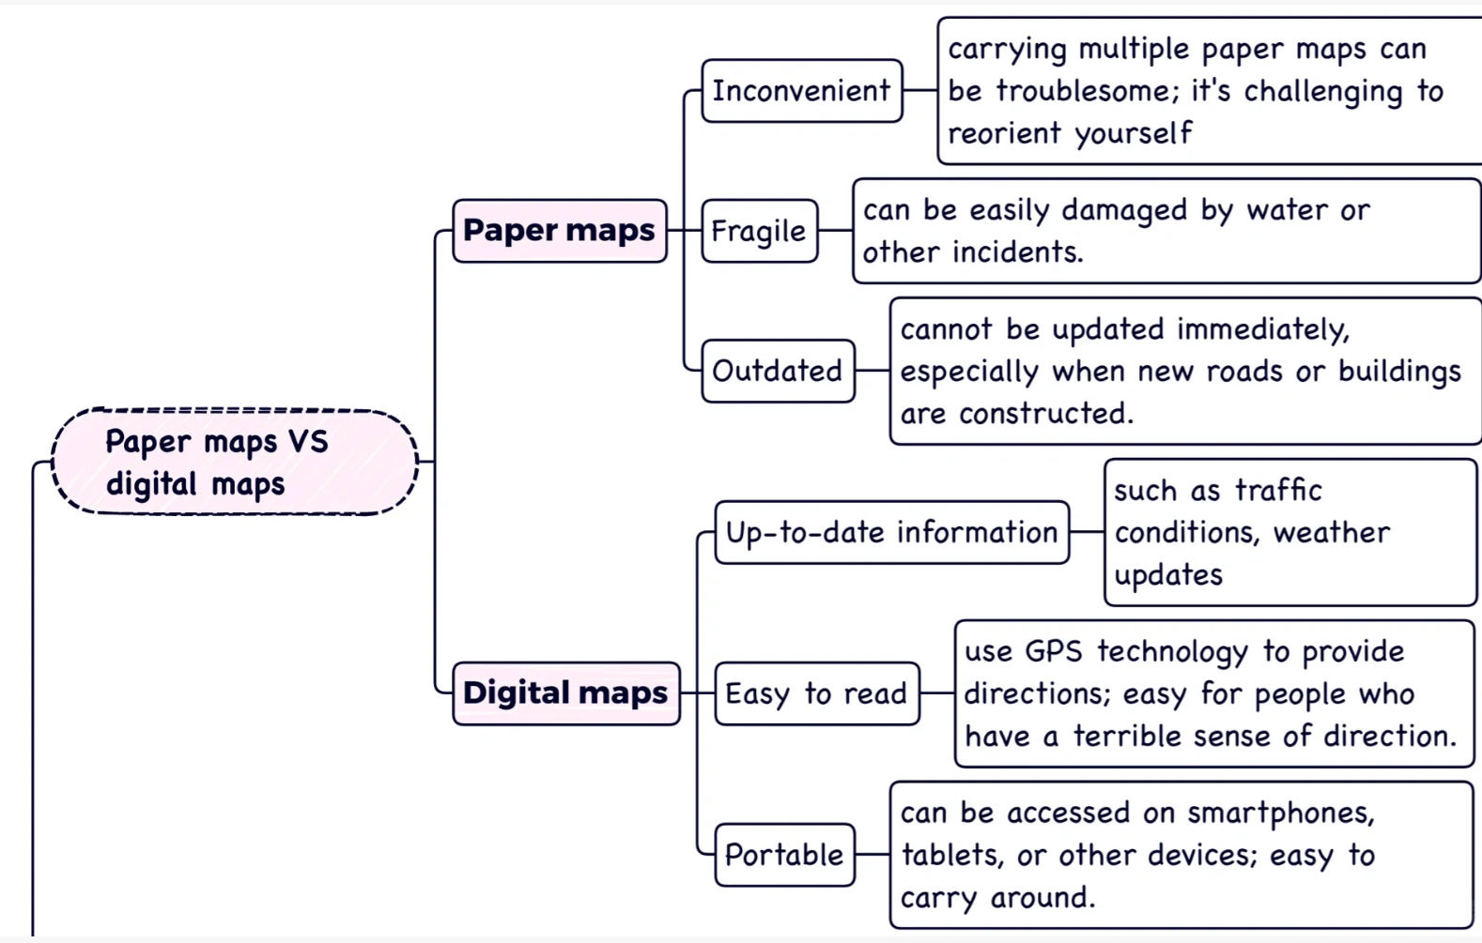
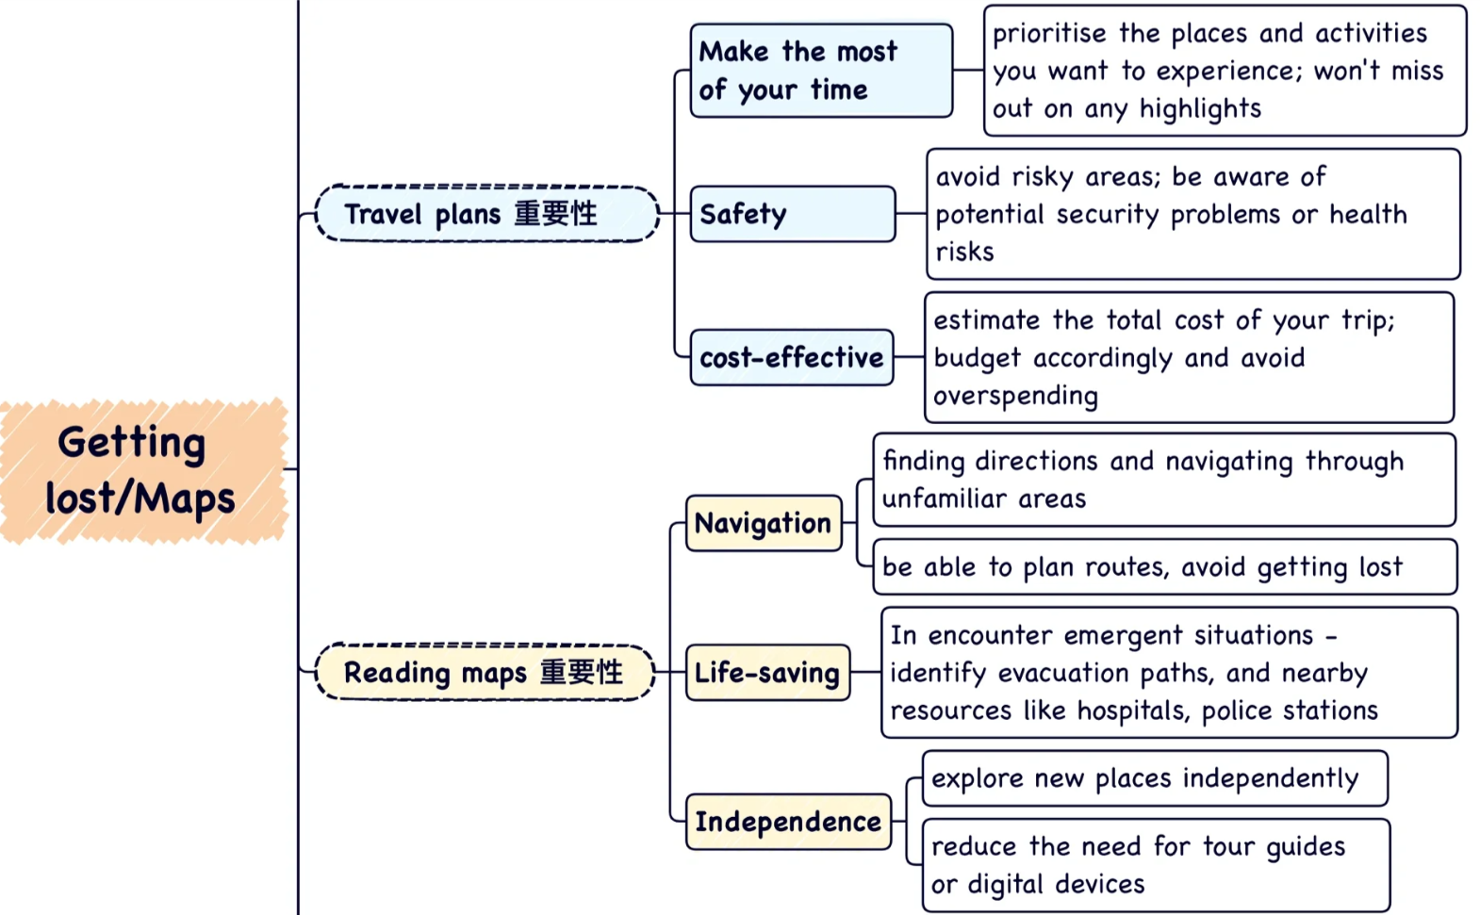
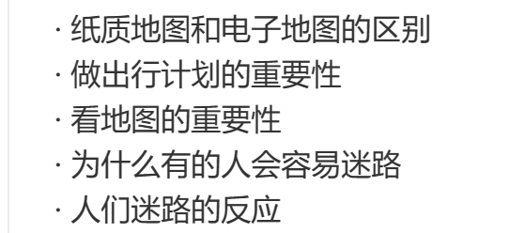
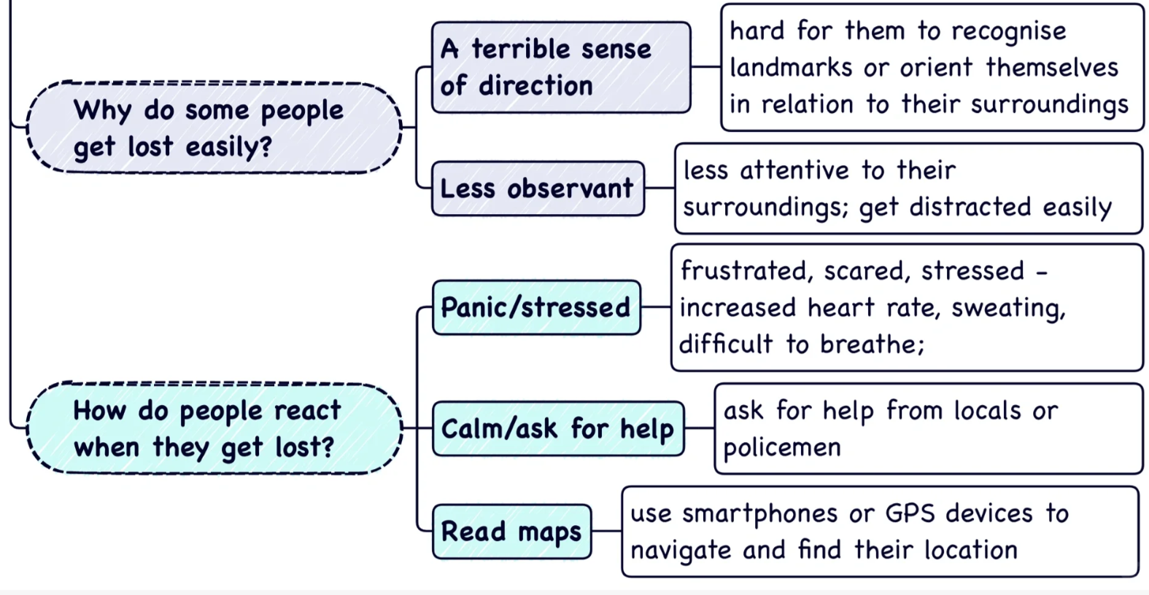
Getting lost

Slide 8
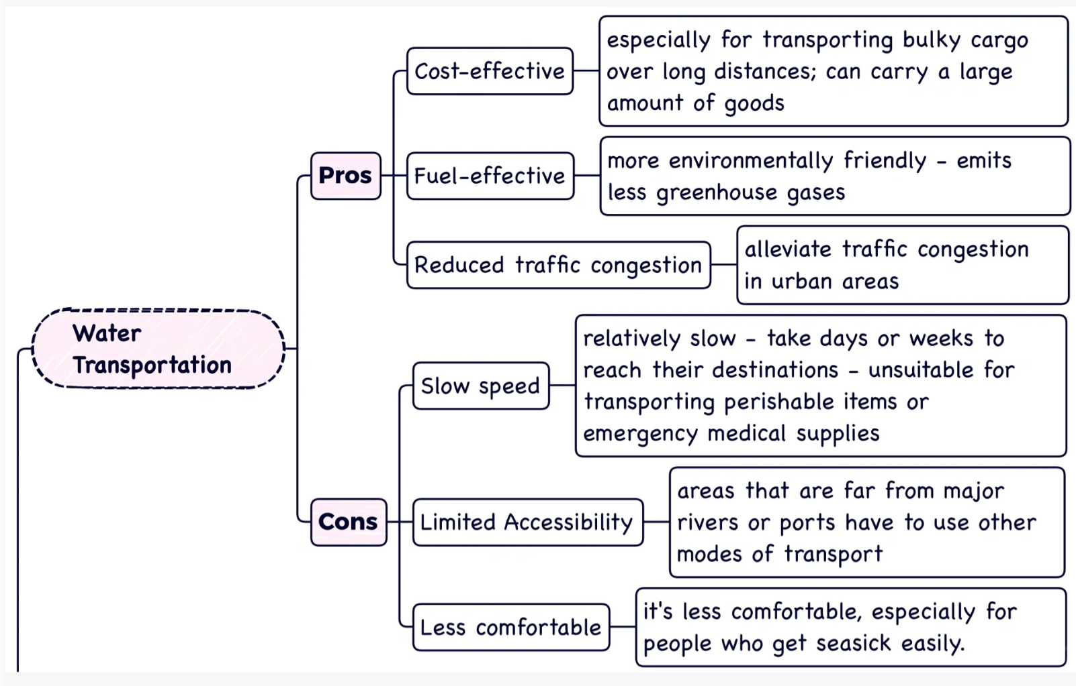
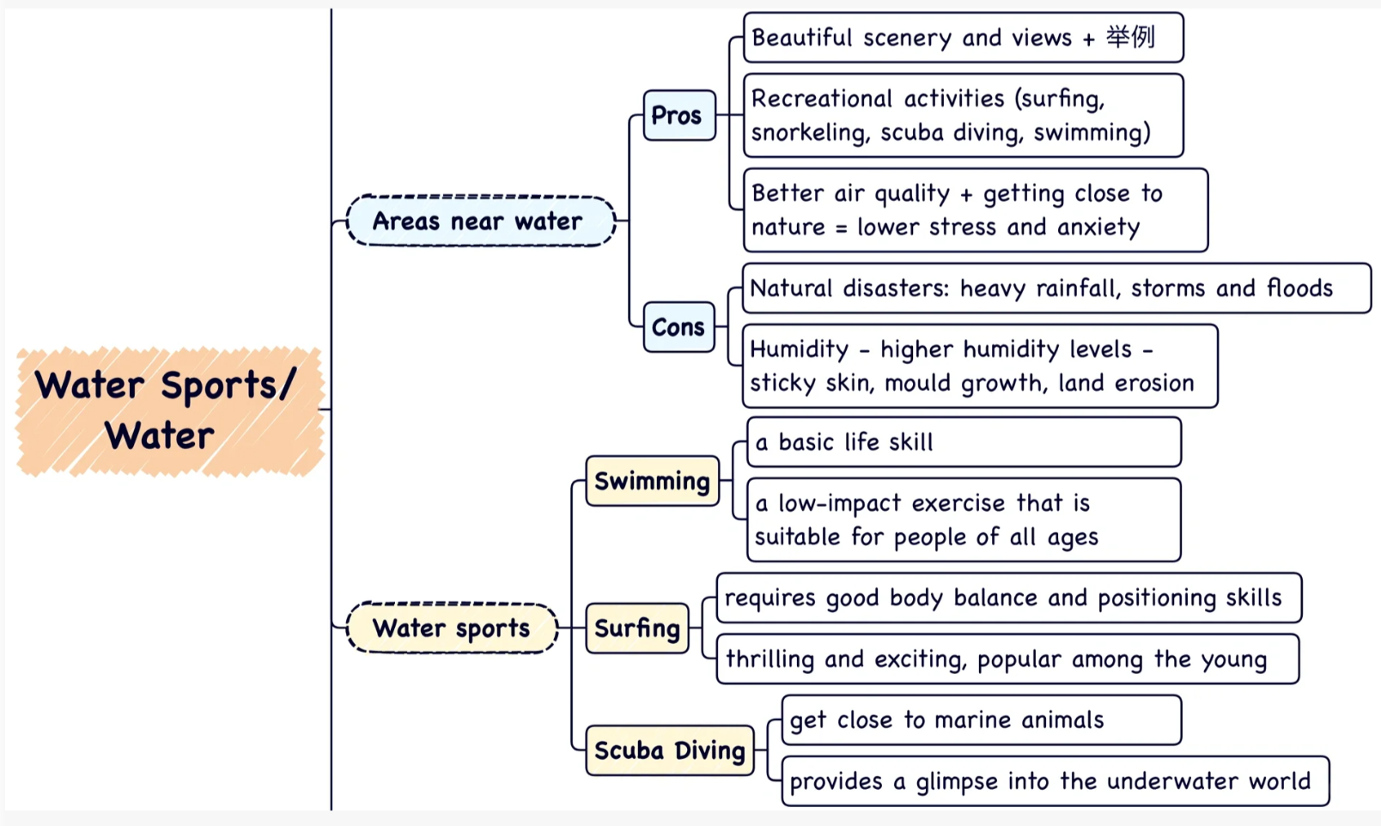
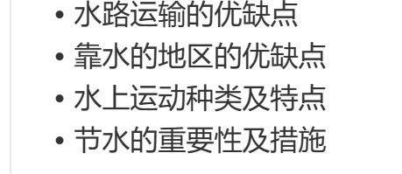
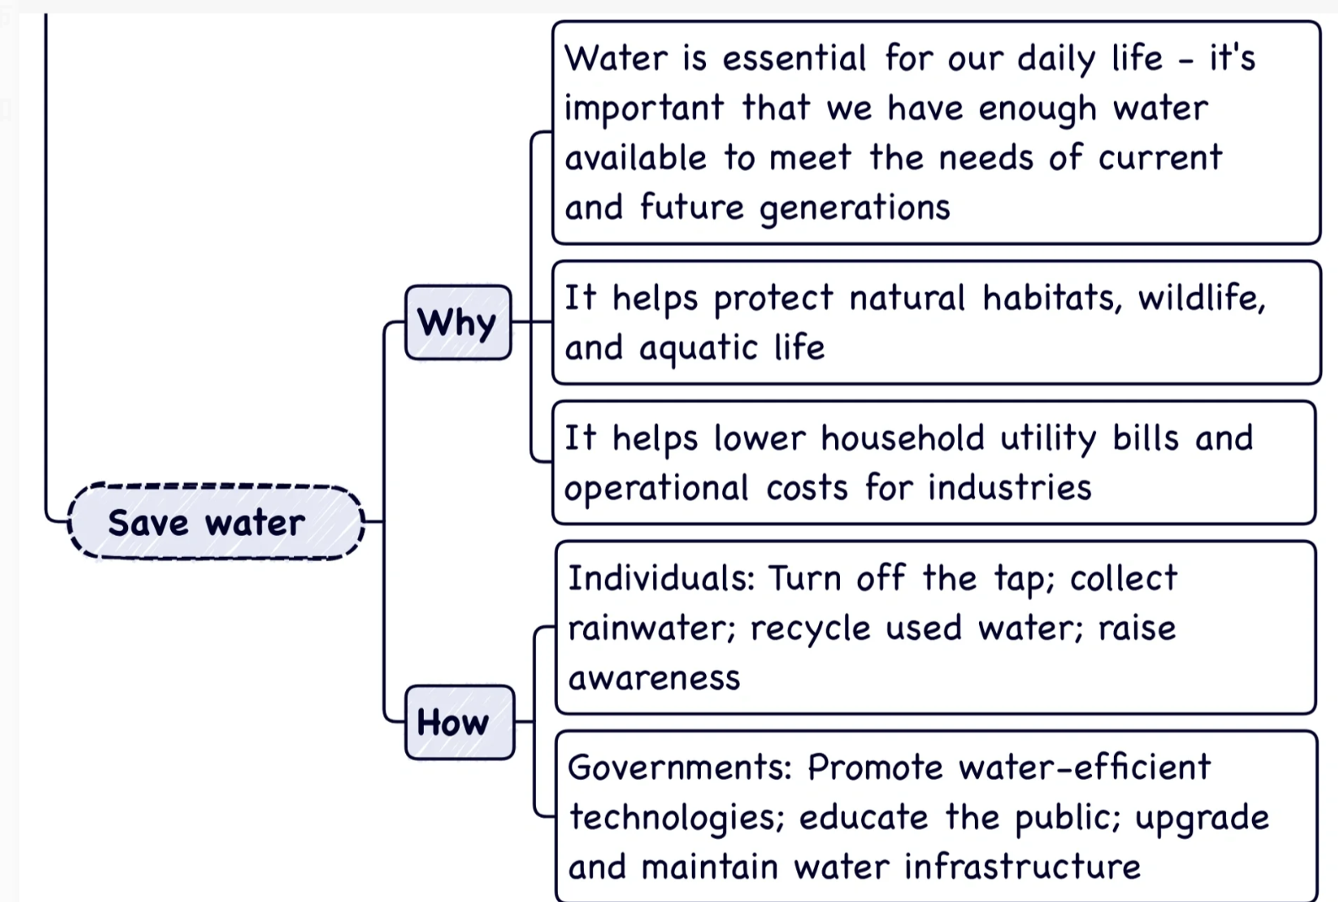
Water sports

Slide 9
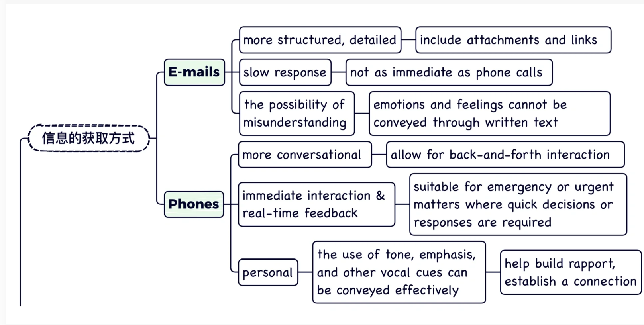
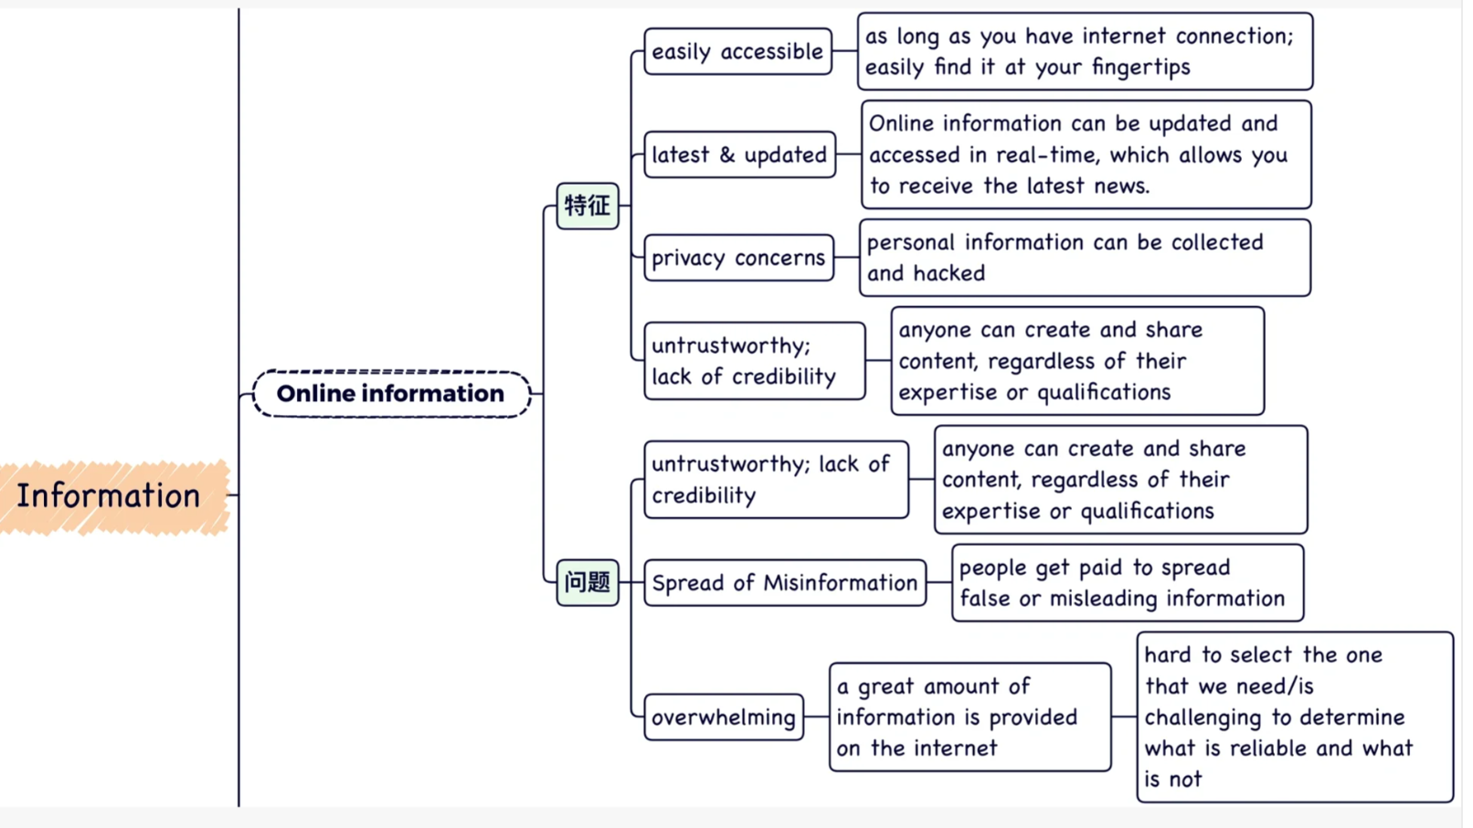

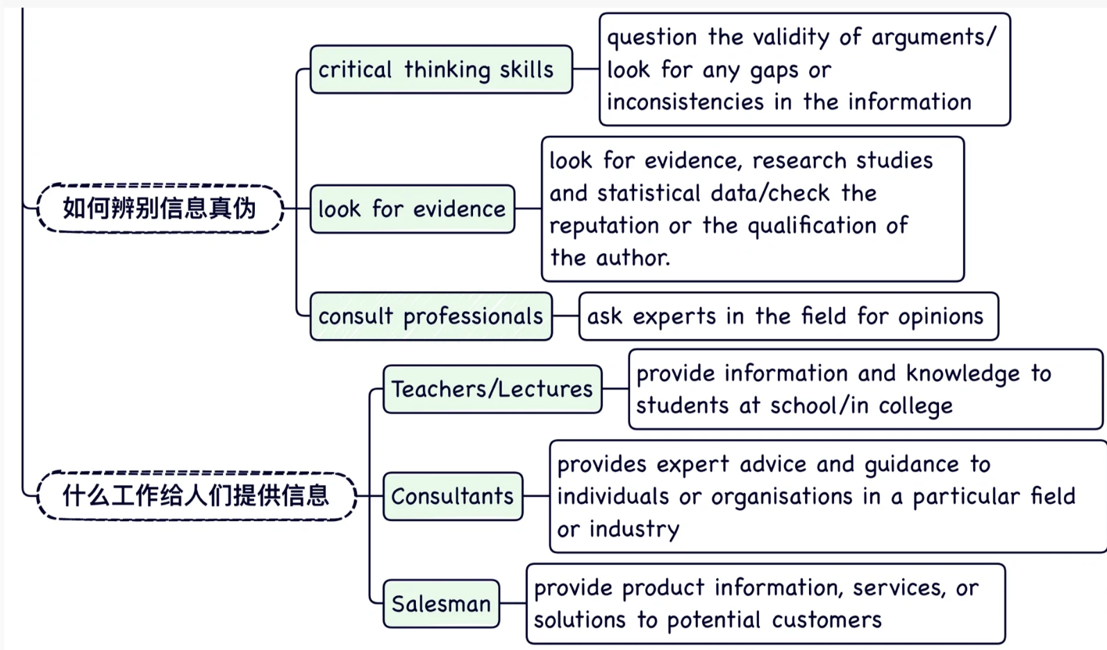
Information

Slide 10
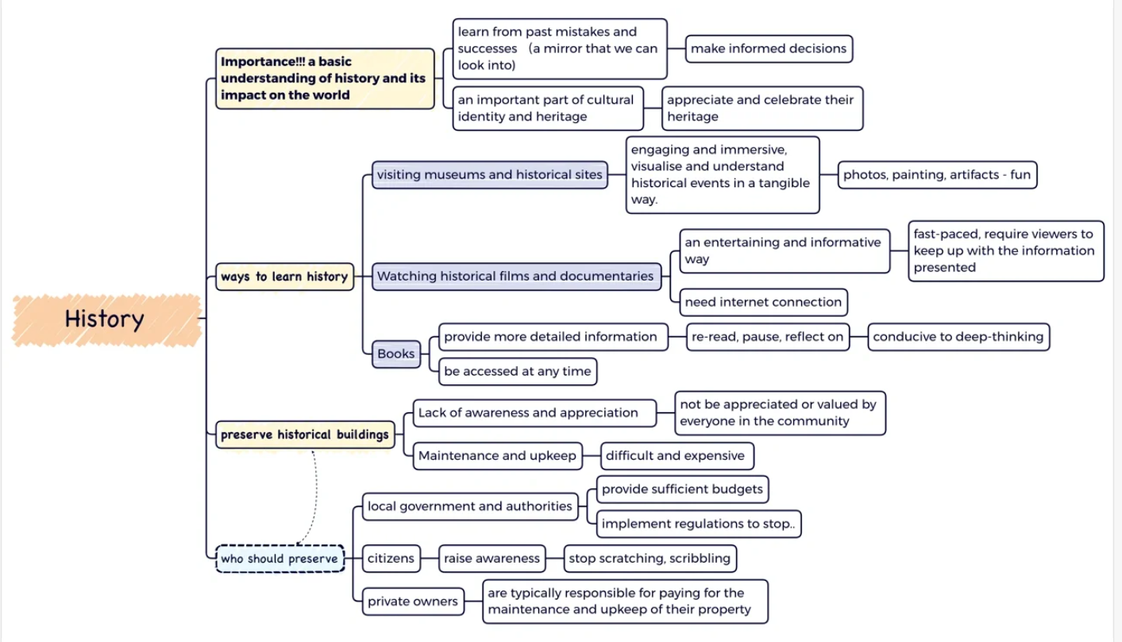
History

Slide 11
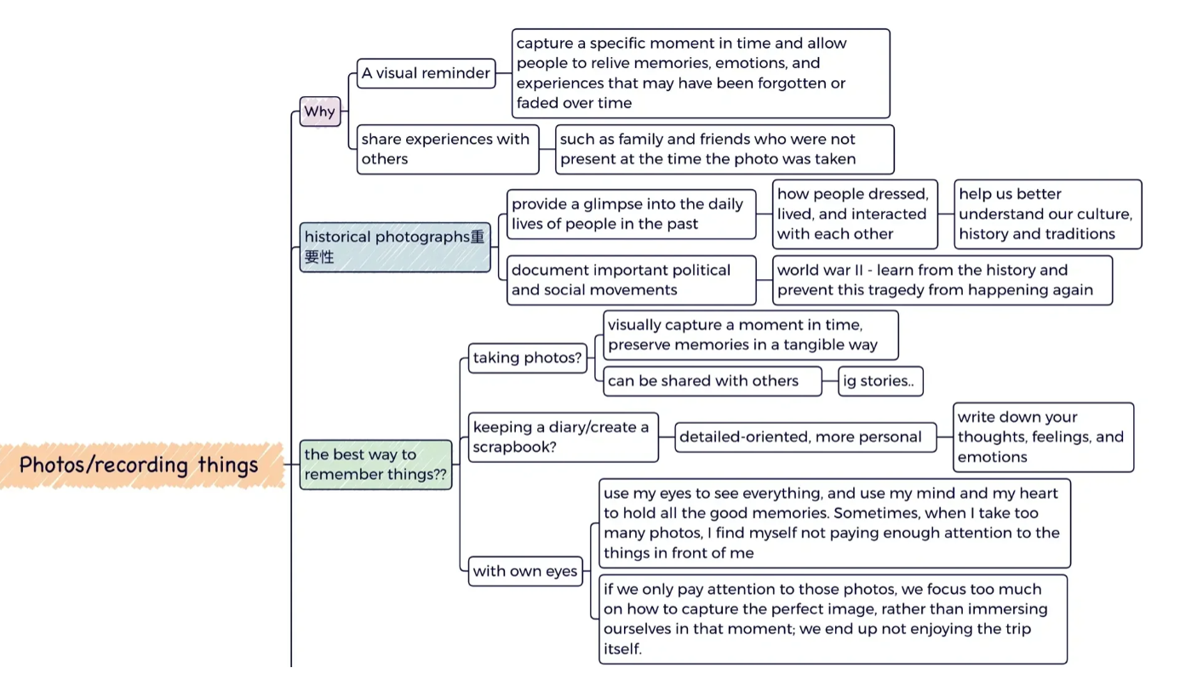
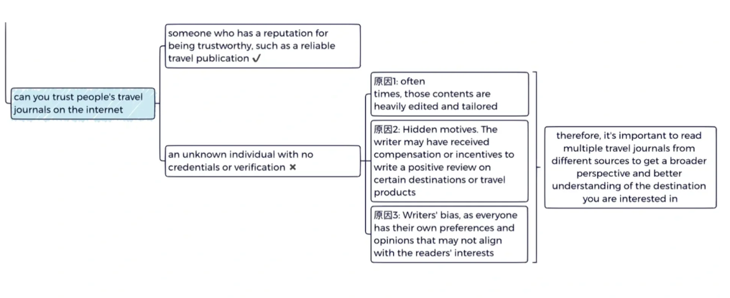
触目惊心的：startling, shocking
Photos

Slide 12
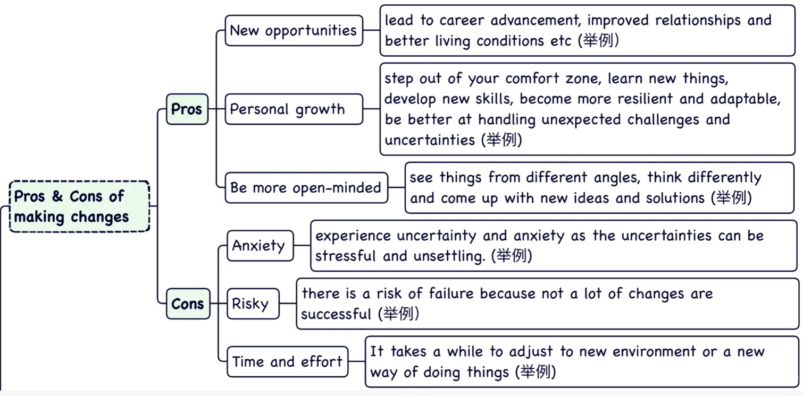
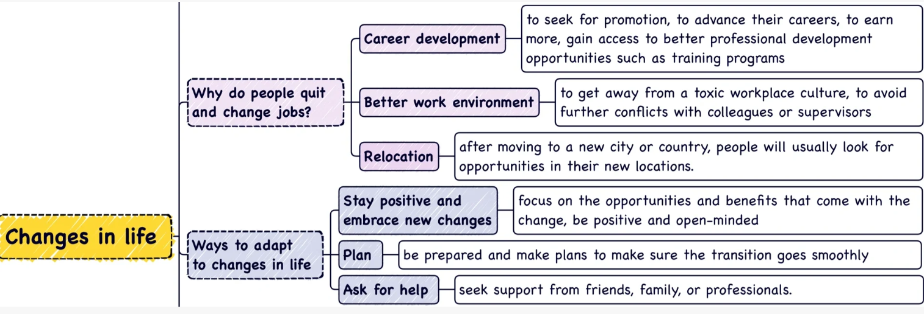
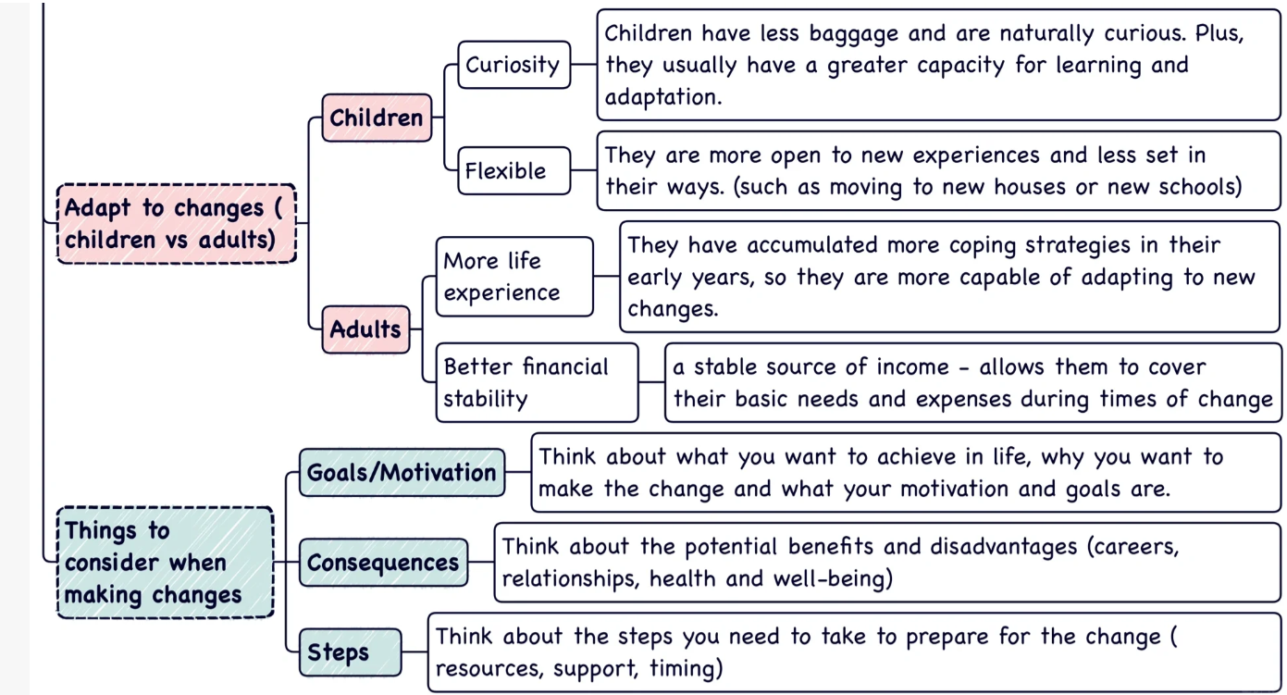
Changes

Slide 13
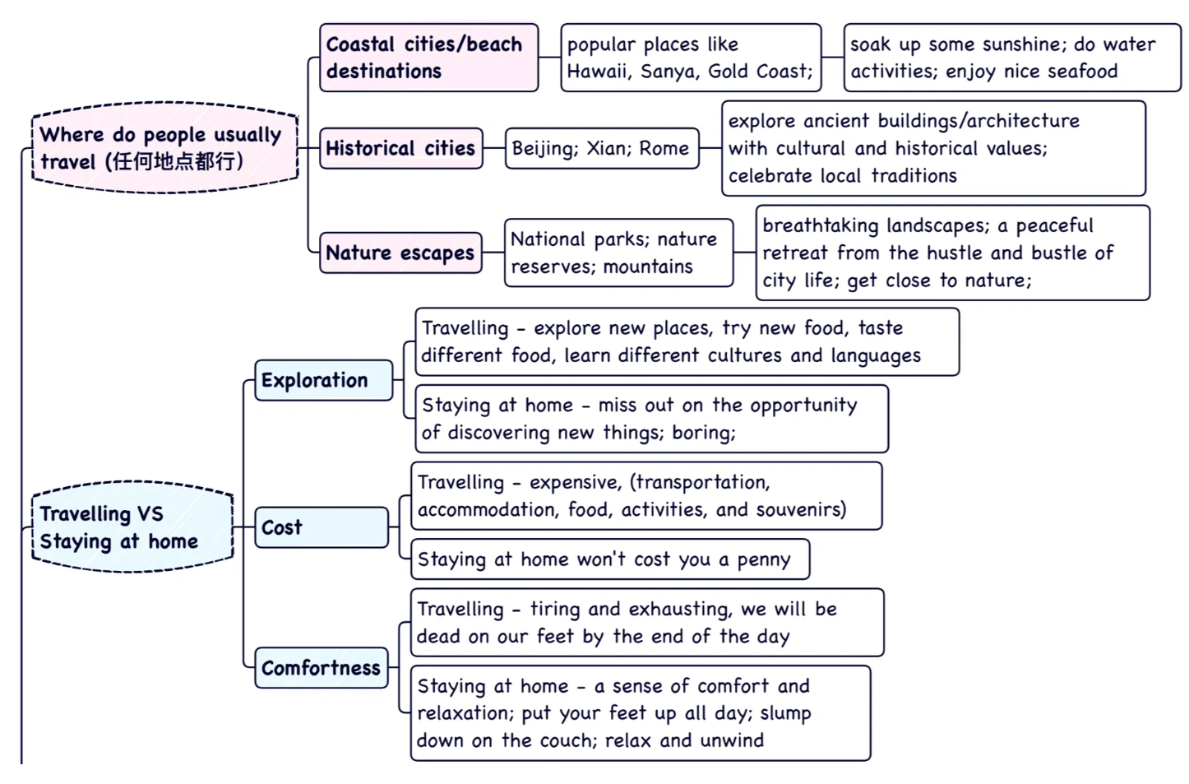
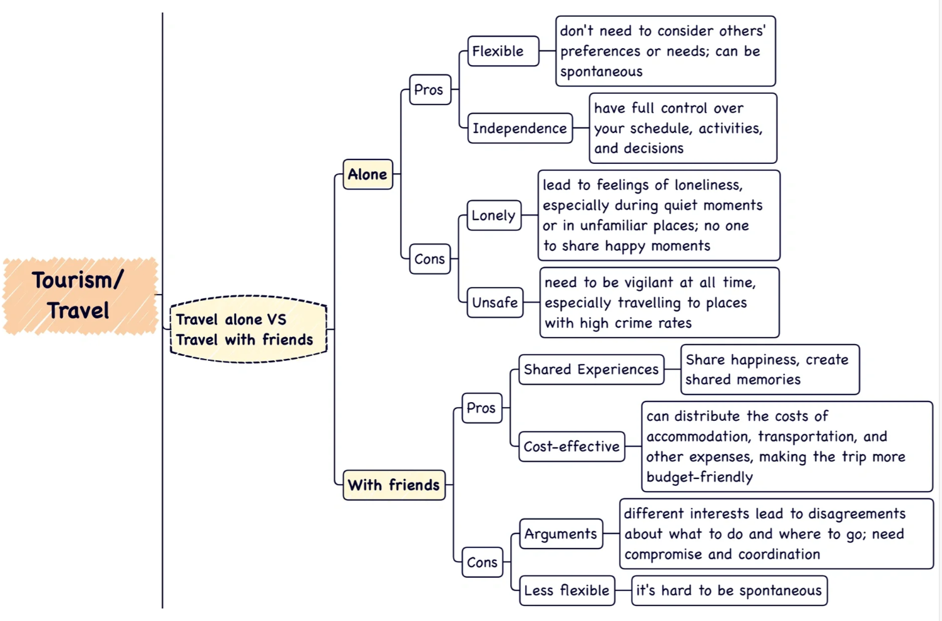
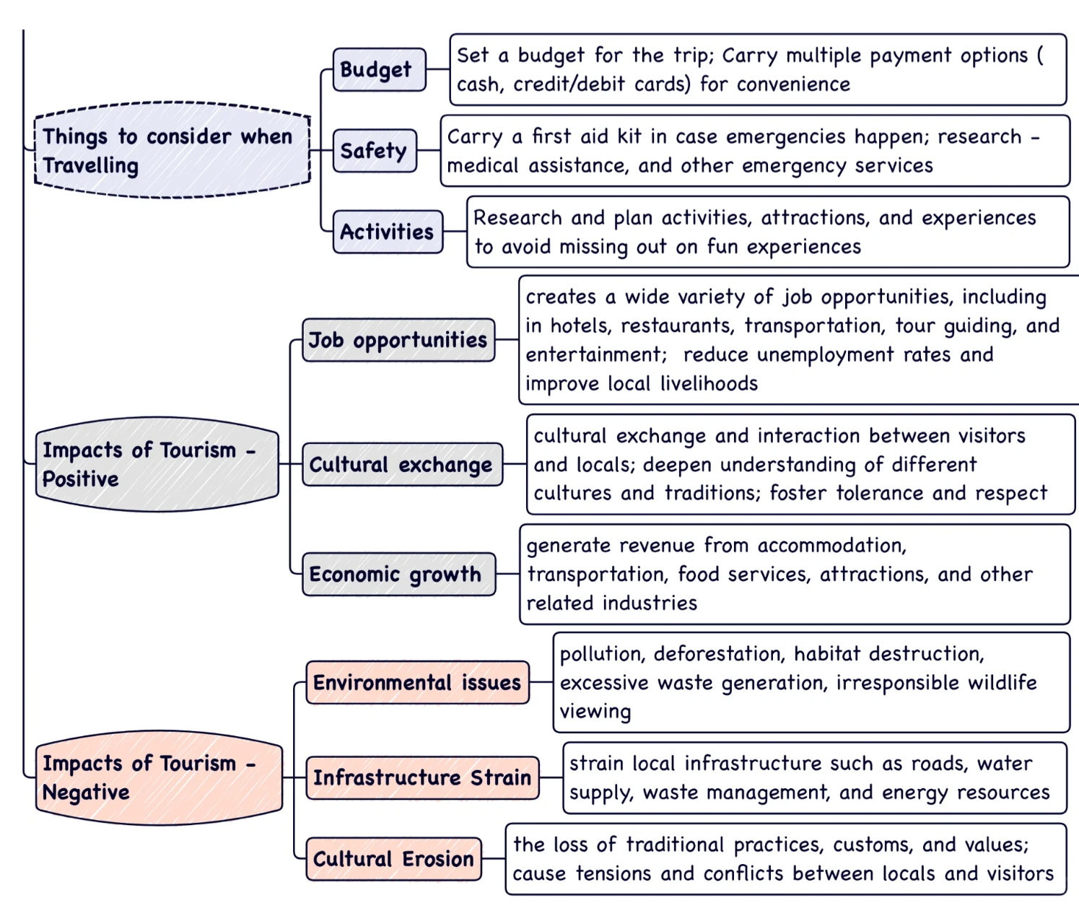
Travel

Slide 14
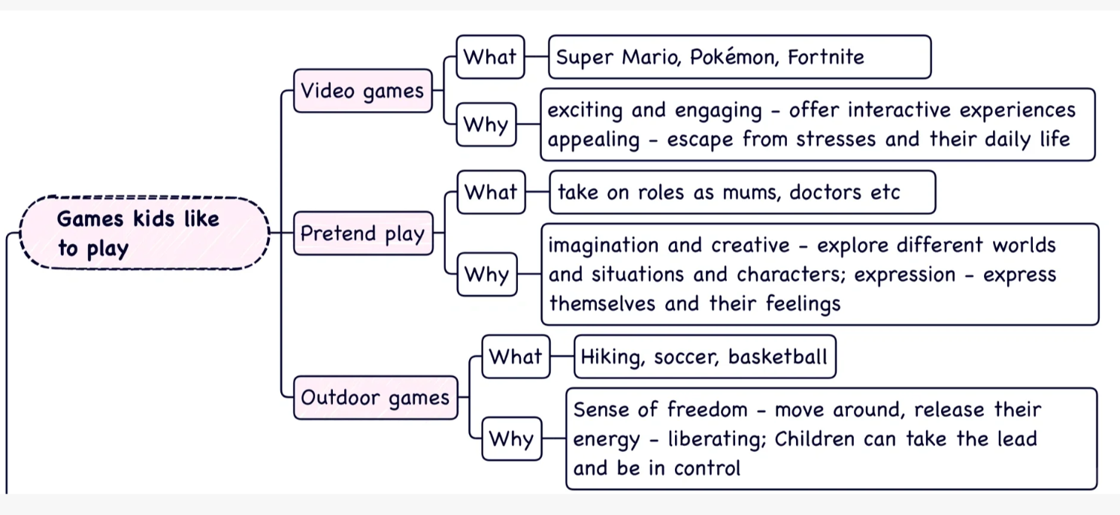
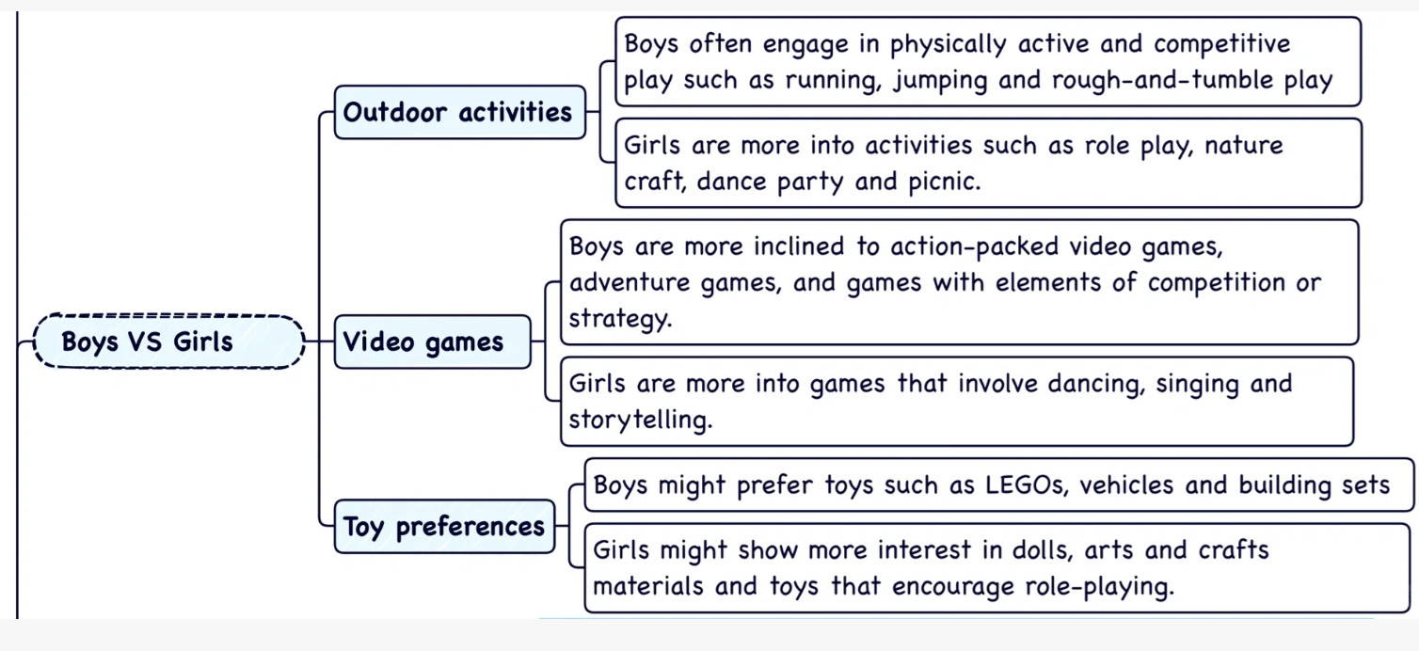
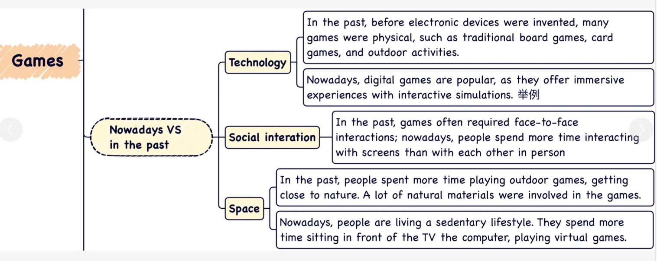
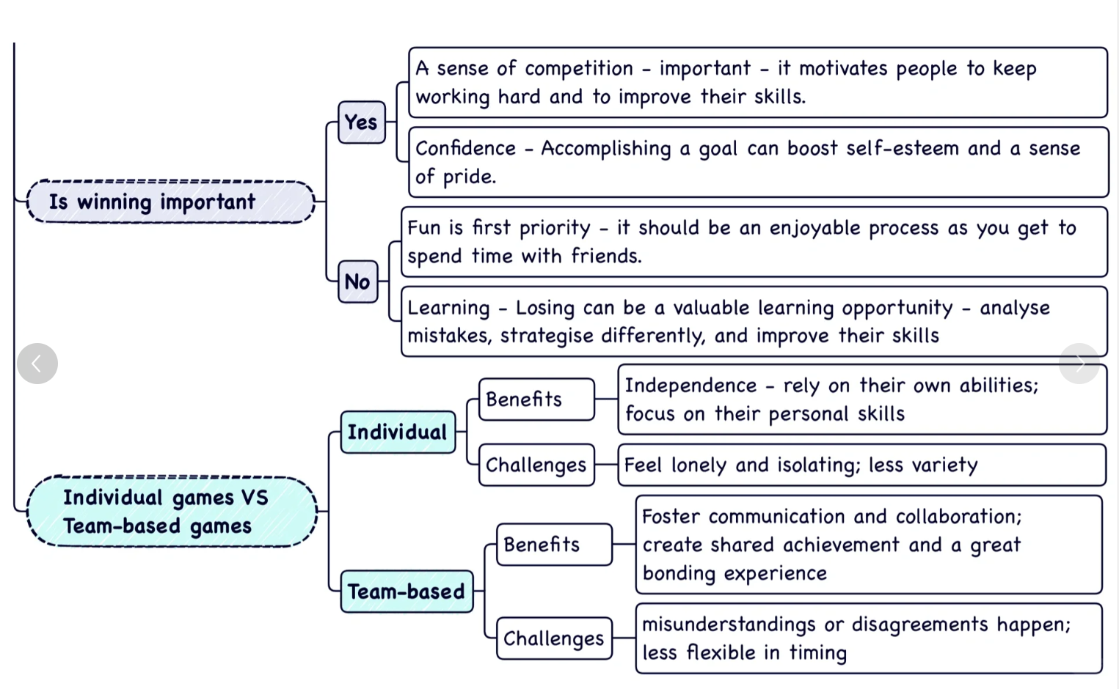
Games

Slide 15


Goals

Slide 16
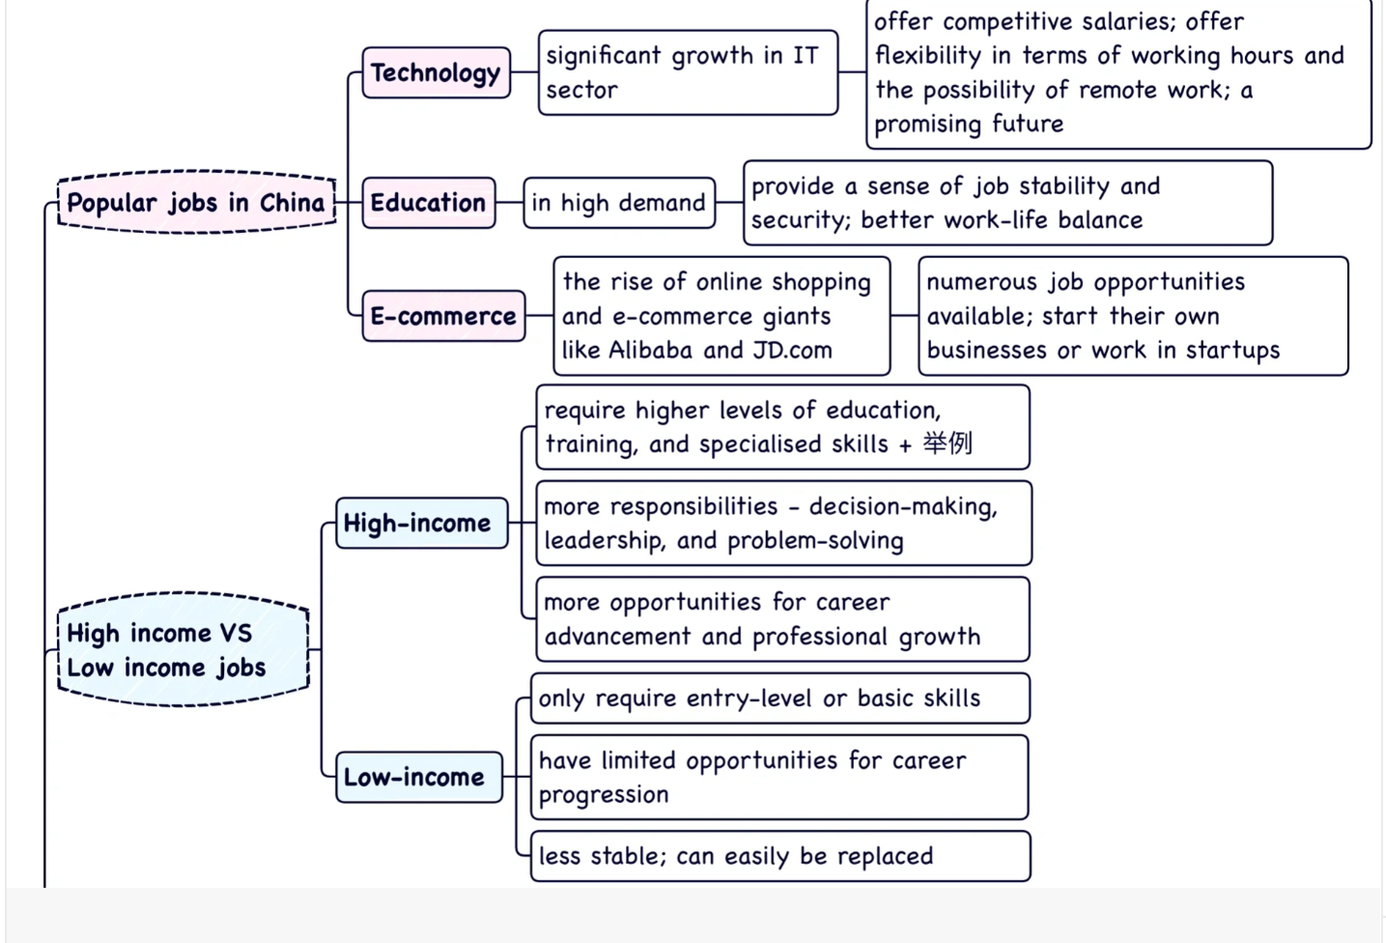
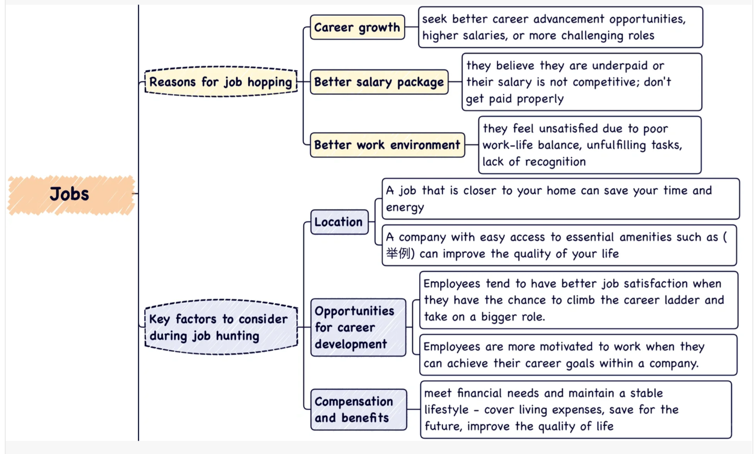
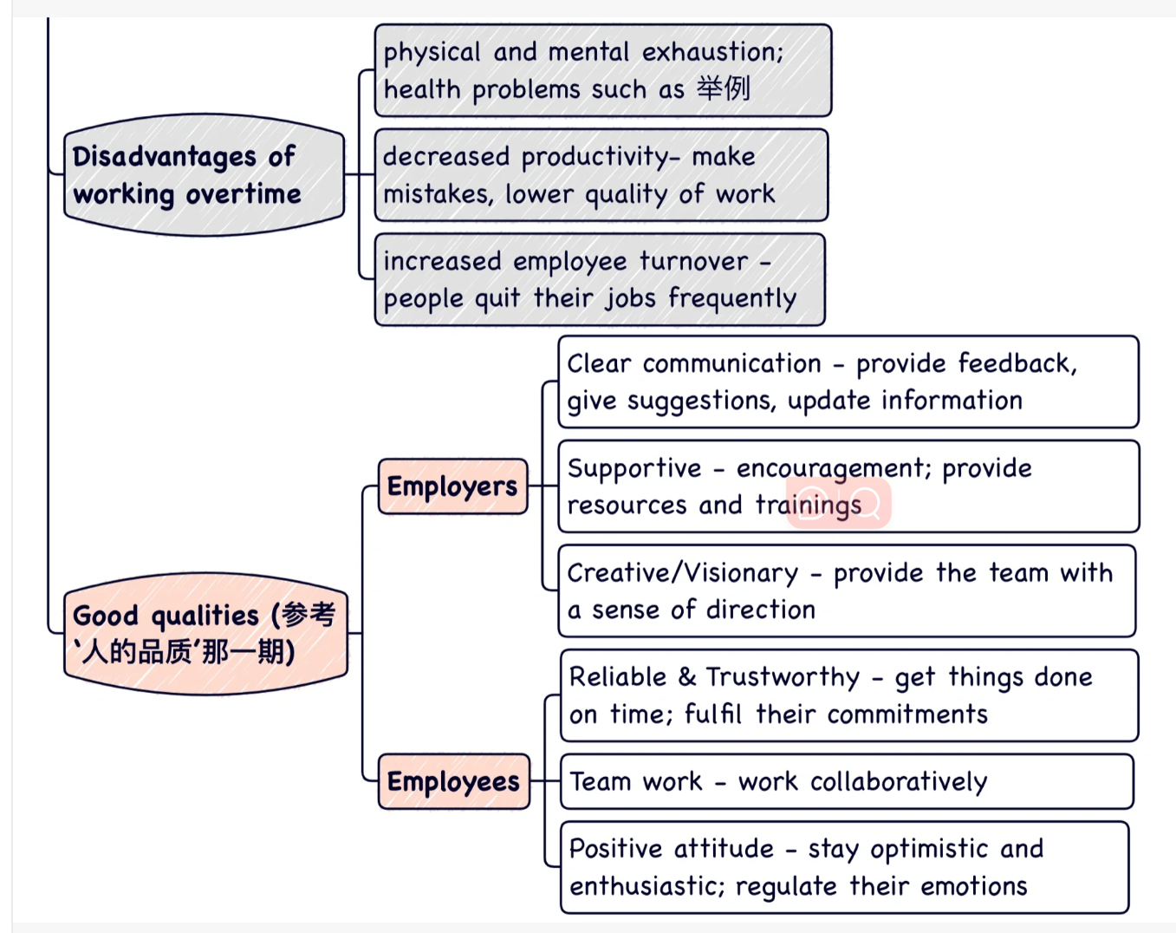
Jobs

Slide 17
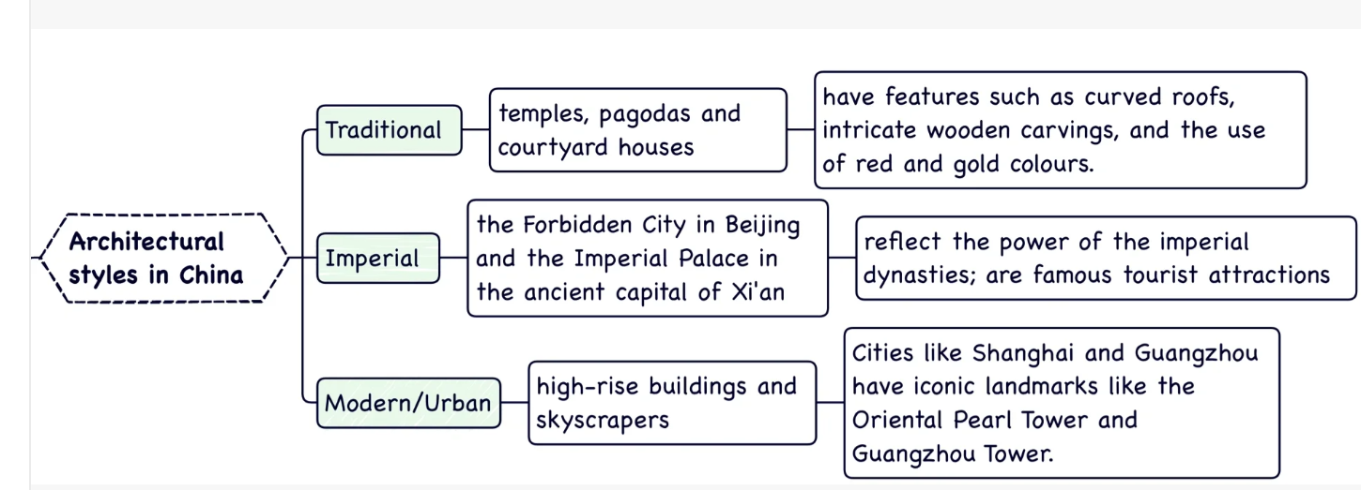
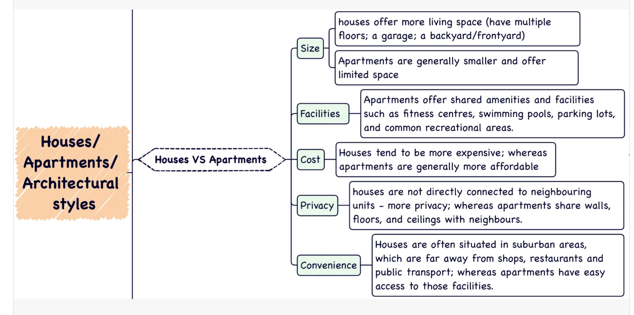
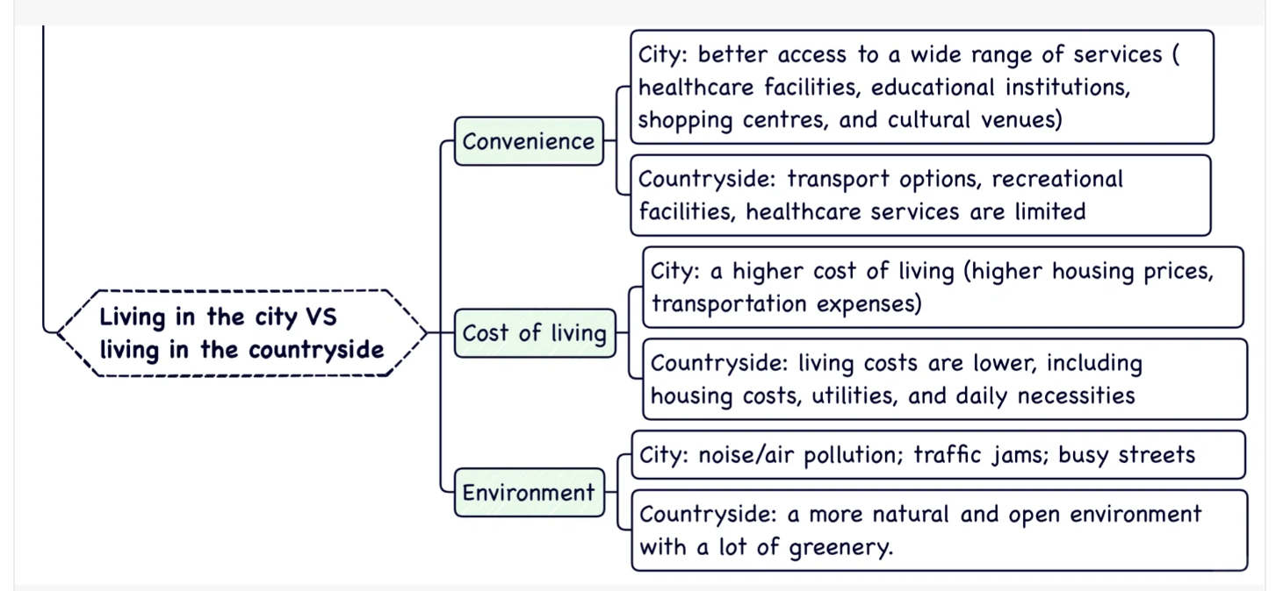
Houses

Slide 18

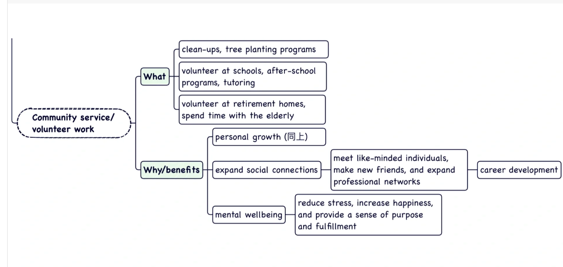
Help

Slide 19



Books

Slide 20



Clothes

Slide 21





Celebrations

Slide 22

Transport

Slide 23





1.Line Chart
Introduction(Paraphrase)
Overview(2 main ideas)

Slide 24








2.Bar Chart
1）Group:具有相似特征的柱子放在一起讲
2）涵盖Changes over time & Comparison
Details-1
Details-2
Introduction(Paraphrase)
Overview(2 main ideas)

Slide 25







3.Pie Chart
Details-1
Details-2
Introduction(Paraphrase)
Topic & Legend
Overview(2 main ideas： most similarity & Difference)

Slide 26









4.Table Chart
1）Can’t choose all the data
Details-1
Details-2
Introduction(Paraphrase)
Overview(2 main ideas： most similarity & Difference)

Slide 27






5.Two Charts
1）describe each chart separately
Details-1
Details-2
Introduction(Paraphrase)
Overview(2 main ideas: Each chart)

Slide 28







6.Process diagram(including Maps)
1）Step language
2) Passive verbs
Overview(2 main ideas: Each chart)
Details-1
Details-2
Introduction(Paraphrase)

Slide 29








7.Comparison diagram
1）切换 Verb Tense
Details-1
Details-2
Introduction(Paraphrase)
Overview(2 main ideas: Each chart)

